Slide 1
3/1/2022
The 2022 Showcase Application Process
Iris Wagstaff, PhD, PI
Neela White, Co-PI

Slide 2
The American Association for the Advancement of Science (AAAS)
Journals
Mission:
"advance science, engineering, and innovation throughout the world for the benefit of all people."
Inclusive STEM Ecosystems for Equity & Diversity (ISEED)
AAAS Website Science Careers
https://www.aaas.org/ https://www.sciencemag.org/careers

Slide 3
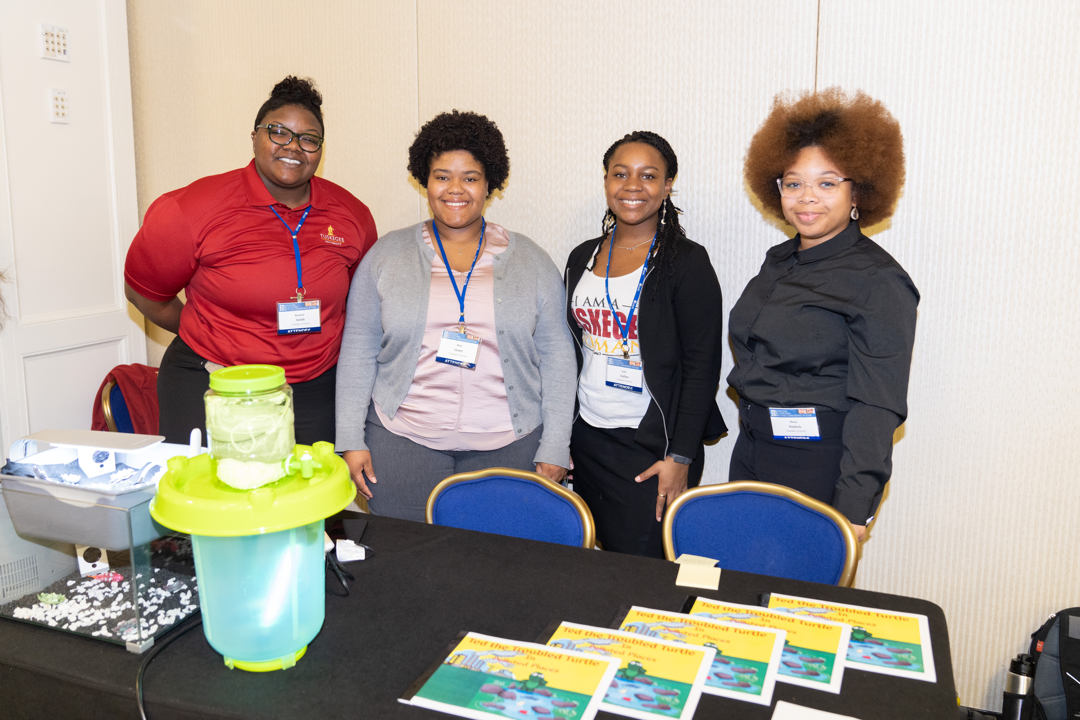
Enhancing HBCU Making and Innovation Capacity via an Inclusive Community of Practice
Support HBCU students and faculty in making, innovation, entrepreneurship and invention efforts
AAAS HBCU Making & Innovation Showcase
Year-Long Virtual Monthly Engagements
E-Mentoring & Coaching
HBCU Making & Innovation Resources Toolkit
HBCU-UP - Program Info NSF Grant No. 2037362

Slide 4
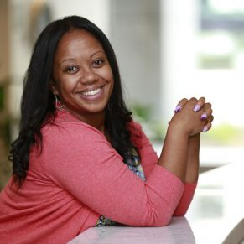
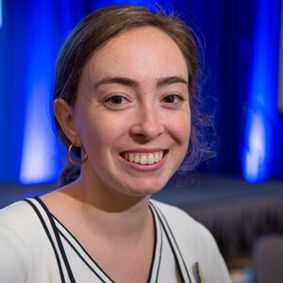
AAAS Project Team
Iris R. Wagstaff, PhD
STEM Program Director, NSF PI
Neela White
Project Director,
NSF Co-PI
Allison Gonzalez
Senior Program Associate

Slide 5
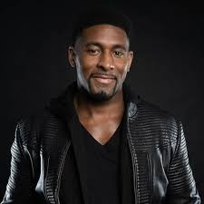
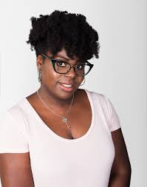
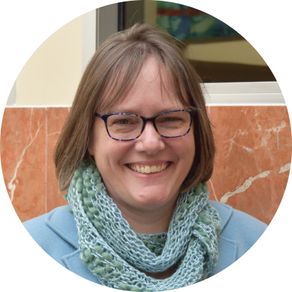
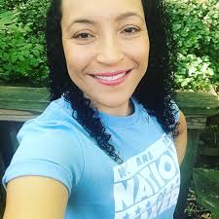
Advisory Board
Quincy Brown, PhD
Director of Innovation, OSTP & Executive Director, BlackcomputHer
Laura Collins, PhD Director IP Development & Commercialization,
NC A&T Office of Technology Transfer
Dorothy Jones-Davis, Executive Director, Nation of Makers
Brandon Andrews
Co-Founder, Gauge Talent Scout, Shark Tank

Slide 6
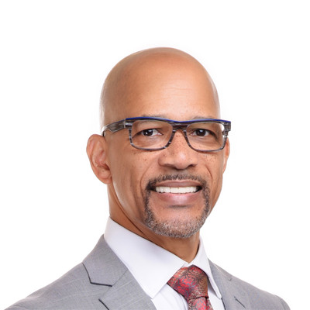
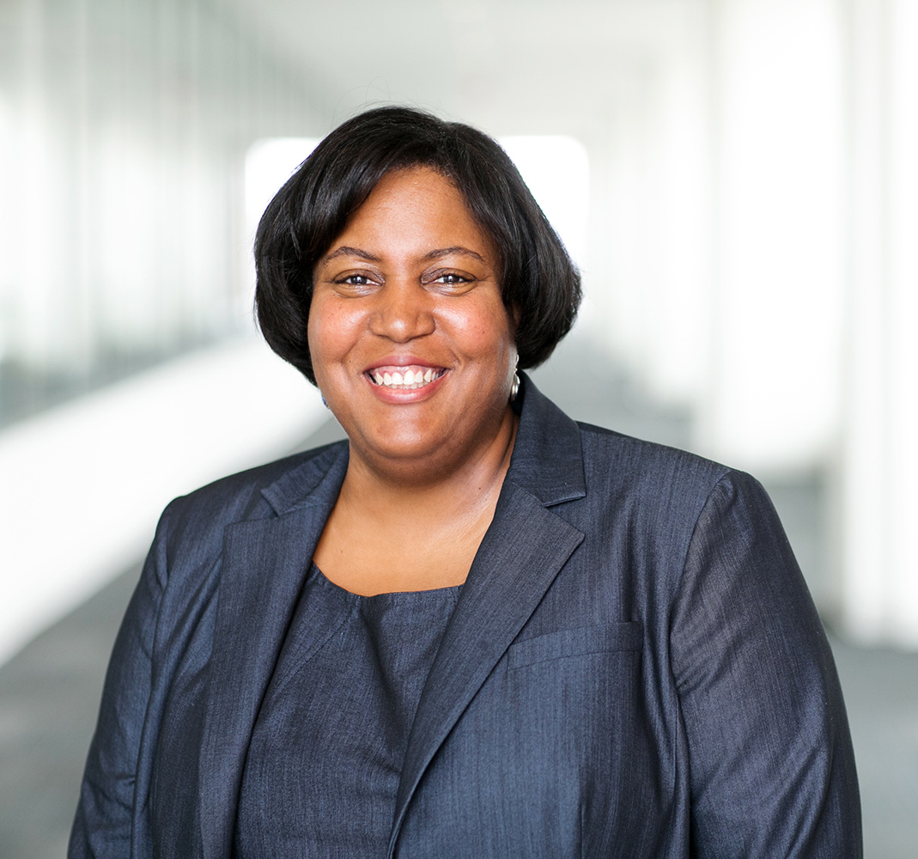
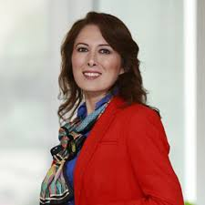
Advisory Board
Ellie Fini, PhD
Assoc Professor, School of Sustainable Engineering
and the Built Environment,
Arizona State University
LaKeisha Greenwade
Founder, CEO Wearable Tech Ventures
Ron Williams, PhD
Founding Director of the Center for Strategic Entrepreneurship
Coppin State University
Joyce Ward
Director, Office of Education, USPTO

Slide 7
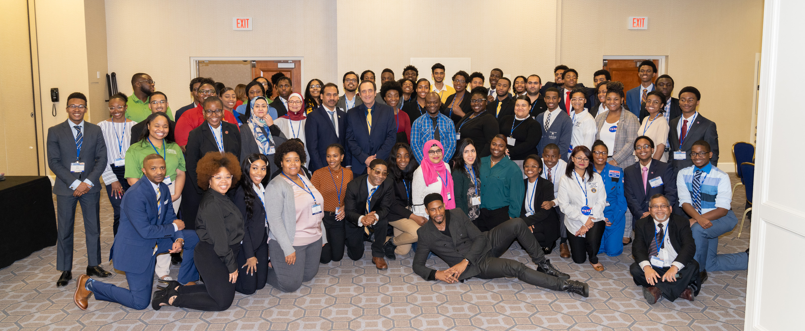
The 2022 AAAS HBCU Making and Innovation Showcase September 22 – 24, 2022 Washington, D.C.

Slide 8
Overview
The HBCU Making and Innovation Showcase was developed to allow HBCU student entrepreneurs, inventors, and innovators to team together to design a hardware or software prototype that addresses one of the 17 United Nation’s Sustainable Development Goals (SDG). With the SDGs as a guiding foundation, teams will be encouraged to research and address social justice and environmental issues in their hometown communities or the community surrounding their institution. This construct for innovation and prototype creation helps teams to contextualize and localize the global issues and challenges that the SDGs address. The Showcase will culminate with a pitch competition.

Slide 9
Overview

Slide 10
Overview
The AAAS HBCU Making & Innovation Showcase will consist of 1.5 days of professional development workshops on topics such as invention, intellectual property protection and communication. The event will culminate in the Showcase pitch competition where student teams will pitch their project prototype to a panel of judges.

Slide 11
Overview
Prizes will include:
$1,200 for the 1st place team
$800 for the 2nd place team
$400 for the 3rd place team

Slide 12
Showcase Requirements
To participate one (1) team member will complete the online application and PowerPoint template.
Projects can be a new prototype or one developed in previous academic years.

Slide 13
Showcase Application Deadline
The deadline for the application is 11:59pm EST, Monday, March 18th, 2022.
Teams will be notified of acceptance via email on Friday, March 28th, 2022.

Slide 14
Accepted Teams
Accepted teams (team members and faculty member) will receive a travel award that covers the housing, airfare, and ground transportation travel to Washington, D.C.

Slide 15
The 2022 Application PowerPoint Template

Slide 16
Project Title

Slide 17
Project Name & Institution
Team Members and Faculty – List all team members and the faculty advisor
Ex. Joe Smith, Freshman, Major: Engineering
Ex. Jon Johnson, PhD, Professor of Electrical Engineering, Department of Engineering

Slide 18
Project Name & Institution
UN Sustainable Development Goal – List the UN SDG that your project will address
Ex. Our project addresses UN SDG 4 Quality Education (projects may address more than one SDG)

Slide 19
Project Name & Institution
Social Justice, Educational, Environmental, Public Health or Other Issue – Describe the social justice, educational, environmental, public health, or other issue that your team’s innovation is addressing.
Ex. Our project is addressing the education disparities in New Orleans, post Hurricane Katrina.

Slide 20
Project Name & Institution
Project Description – Describe your prototype, list how the prototype is constructed (software, app, water filtration system, etc), and how this prototype provides a solution to the problem that you are addressing, as well as background research to support why you chose this problem and developed this solution.
Identify the audience for this project
*If you are a returning team, and you are submitting a project similar to a previously accepted project, you must be able to describe and demonstrate how this project/prototype has been improved from its previous iteration.

Slide 21
Timeline

Slide 22
Timeline – Important Dates
Monday, February 14th – Application opens
Friday, March 18th, 11:59pm EST – Application closes
Week of March 28th – Teams are notified of their acceptance
Monday, April 4th – Teams confirm participation in the Showcase
Friday, April 29th, 11:59pm – Deadline for Showcase registration
Wednesday, May 31st - Deadline for video pitch submissions - round 1
Monday, June 6th – Hotel and travel reservations open
Friday, July 30th – Deadline to submit videos of prototype demonstration
Friday, August 5th - Deadline to reserve hotel and travel
Monday, August 22nd - Deadline for final video pitch submissions
Thursday, September 22nd – Saturday, September 24th – AAAS HBCU Making & Innovation Showcase

Slide 23
Timeline – Application Period
Beginning, Monday, February 14th, interested teams may begin the AAAS HBCU Making & Innovation Showcase application process. Teams will select one (1) team member to apply on behalf of the team.
The application must be completed by 11:59pm ET on Friday, March 18th. No applications will be accepted after the deadline.
Teams that are accepted to participate in the Showcase will be required to confirm their participation in the Showcase by Monday, April 4th, 2022.

Slide 24
Timeline – Registration Period
Beginning, Monday, April 4th, accepted team and faculty members will register for the conference.
Once registered, team members will receive instructions on how to book travel to Washington, DC, and how to reserve a hotel room.

Slide 25
Timeline – Registration Period
All team members and faculty advisors will be required to be fully vaccinated (or have an accepted medical or religious exemption). Participants will be required to complete a waiver and provide proof of vaccination.
Travel and hotels confirmations will be submitted by August 8, 2022. Confirmations for hotels will be sent approximately three (3) weeks before the Showcase.

Slide 26
Timeline – Implementation Period
Teams will be required to attend a monthly e-mentoring lunch and learn
Teams will also be required to attend the bi-monthly AAAS HBCU Making and Innovation webinar series to get tips on working on their projects and pitches.
On May 31st, teams will submit a 2-minute pitch video. A mentor will review the videos, provide feedback and the teams will be allowed to submit an updated video of their pitch by August 22nd.

Slide 27
Timeline - Showcase
Thursday, September 22nd - orientation and opening plenary.
Friday, September 23rd – student and faculty workshops and faculty evaluation groups. Faculty will also participate in evaluation groups.
Saturday, September 24th – Showcase pitch competition. Students will participate in evaluation focus groups. The event will conclude with the awards luncheon

Slide 28
Frequently Asked Questions FAQs

Slide 29
FAQs
Eligibility
Q: What institutions are eligible to apply for the HBCU Making and Innovation Showcase?
A: Student teams that are eligible to apply for the Showcase would be from one of the 101 accredited institutions listed by the National Center for Education Statistics.
~
Q: How many students can be on a team?
A: There can be a minimum of three (3) students and a maximum of (5) students.
~
Q: Must the student be classified as an undergraduate to participate on the student team?
A: No, students can be both undergraduate and graduate.

Slide 30
FAQs
Eligibility
Q: What is the maximum number of teams that are able to apply from each institution?
A: An institution can have as many teams as they wish apply for the Showcase. However, no more than two (2) teams from any given institution will be selected to participate.
~
Q: Will students that attend the Showcase be able to choose their roommate?
A: No, students will not have a choice in their roommate. Students will be paired with a roommate of the same gender. We will do our best to pair students with a roommate from the same team/institution.

Slide 31
Audience Questions

Slide 32
THANK YOU!!
The slides and recording will be posted on the HBCU Making & Innovation website https://iie.aaas.org/ .
Please complete the post-webinar survey via email.
Our next AAAS HBCU Making & Innovation Showcase webinar will be held in May.
Follow us on Social Media:
AAAS HBCU Making & Innovation Twitter: @AAASMaker https://twitter.com/aaasmaker
AAAS HBCU Making & Innovation LinkedIn Page: https://www.linkedin.com/groups/8954208/

