Slide 1
The 2022 AAAS HBCU Making and Innovation Showcase
Opening Plenary
9/22/2022

Slide 2
Iris Wagstaff, PhD Program Director Inclusive STEMM Ecosystems for Equity and Diversity (ISEED) American Association for the Advancement of Science
2022 AAAS HBCU Making and Innovation Showcase Opening Plenary

Slide 3
Travis York, PhD Moderator Director Inclusive STEMM Ecosystems for Equity and Diversity (ISEED) American Association for the Advancement of Science
2022 AAAS HBCU Making and Innovation Showcase Opening Plenary

Slide 4
Sudip Parikh, PhD Chief Executive Officer & Executive Publisher, Science Family of Journals American Association for the Advancement of Science
2022 AAAS HBCU Making and Innovation Showcase Opening Plenary

Slide 5
James L. Moore III, PhD Assistant Director, Directorate for Education and Human Resources National Science Foundation
2022 AAAS HBCU Making and Innovation Showcase Opening Plenary

Slide 6
Christina Tamer Director, Program, Early-Stage Innovators and Venture Development VentureWell
2022 AAAS HBCU Making and Innovation Showcase Opening Plenary

Slide 7
Joey Womack Founder & Chief Executive Officer Goodie Nation
2022 AAAS HBCU Making and Innovation Showcase Opening Plenary

Slide 8
Iris Wagstaff, PhD Program Director Inclusive STEMM Ecosystems for Equity and Diversity (ISEED) American Association for the Advancement of Science
2022 AAAS HBCU Making and Innovation Showcase Opening Plenary

Slide 9
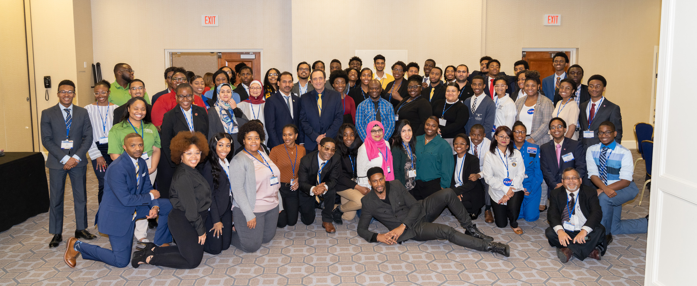
Follow us on Twitter: @AAASMaker and LinkedIn: AAAS HBCU Making and Innovation #2022MakerShowcase

